Slide 1
PSUT 2024 summer physics project
Yaman Diyarbakirli

Slide 2
Introduction: Circuit builder and calculator tool
This is a project written entirely in Java with the purpose of providing a practical tool for simulating and calculating circuit parameters, ideal for students in physics and electrical engineering.

Slide 3
What it Does
Capable of drawing any circuit containing wires, resistors, and batteries.
Simulates the direction of conventional current flow for most circuits.
Calculates the equivalent resistance for circuits with multiple resistors (works for *most* in-series and in-parallel connections)
Calculates the total current flowing through a circuit.
Allows modification of resistor values and battery voltage for dynamic analysis.

Slide 4
Work Distribution
Although the project was developed by myself alone, here are some highlights of the written code:
Write a minimal user interface
Implement a 2D look with a grid
Implement component (resistors, wires and batteries) placement and component interaction with each other
Implement resistance calculation (implemented using an incremental approach)
Debug and handle errors (works most of the time :))
Create user documentation through a README.MD file, written to help with the usage of the tool/app (everything is available on my Github)

Slide 5
Some visuals and screenshots of the tool
(All resistors (colored in blue) in the following screenshots have a resistance of 5 Ohms)

Slide 6
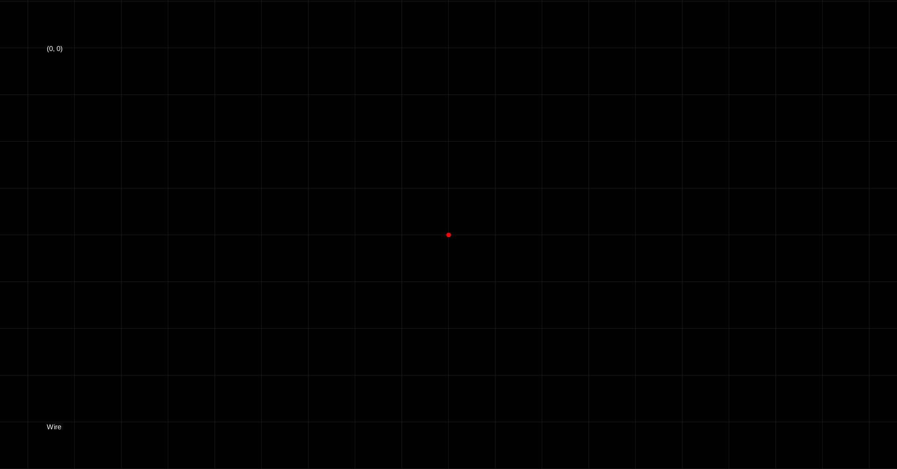

Slide 7
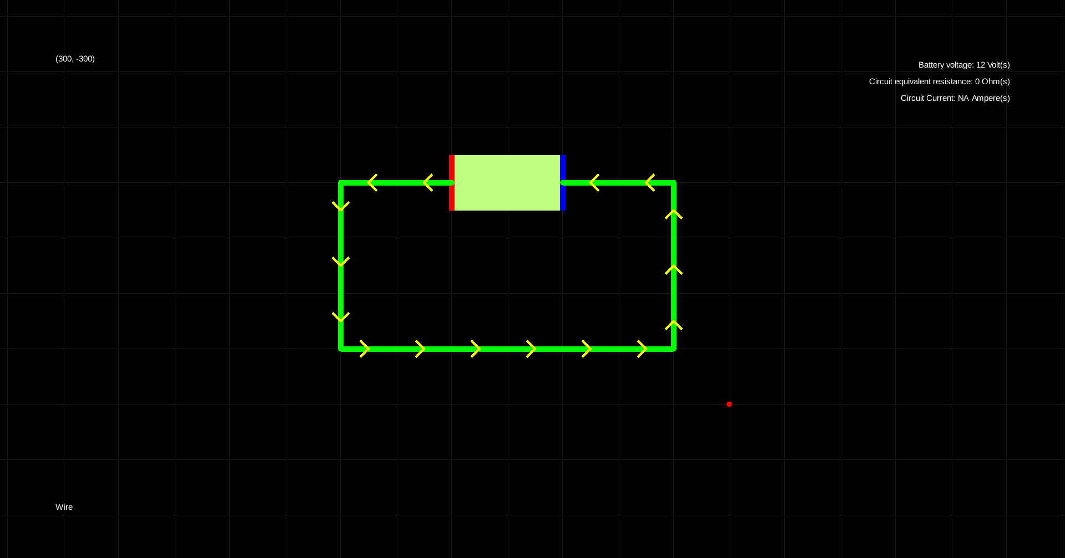

Slide 8
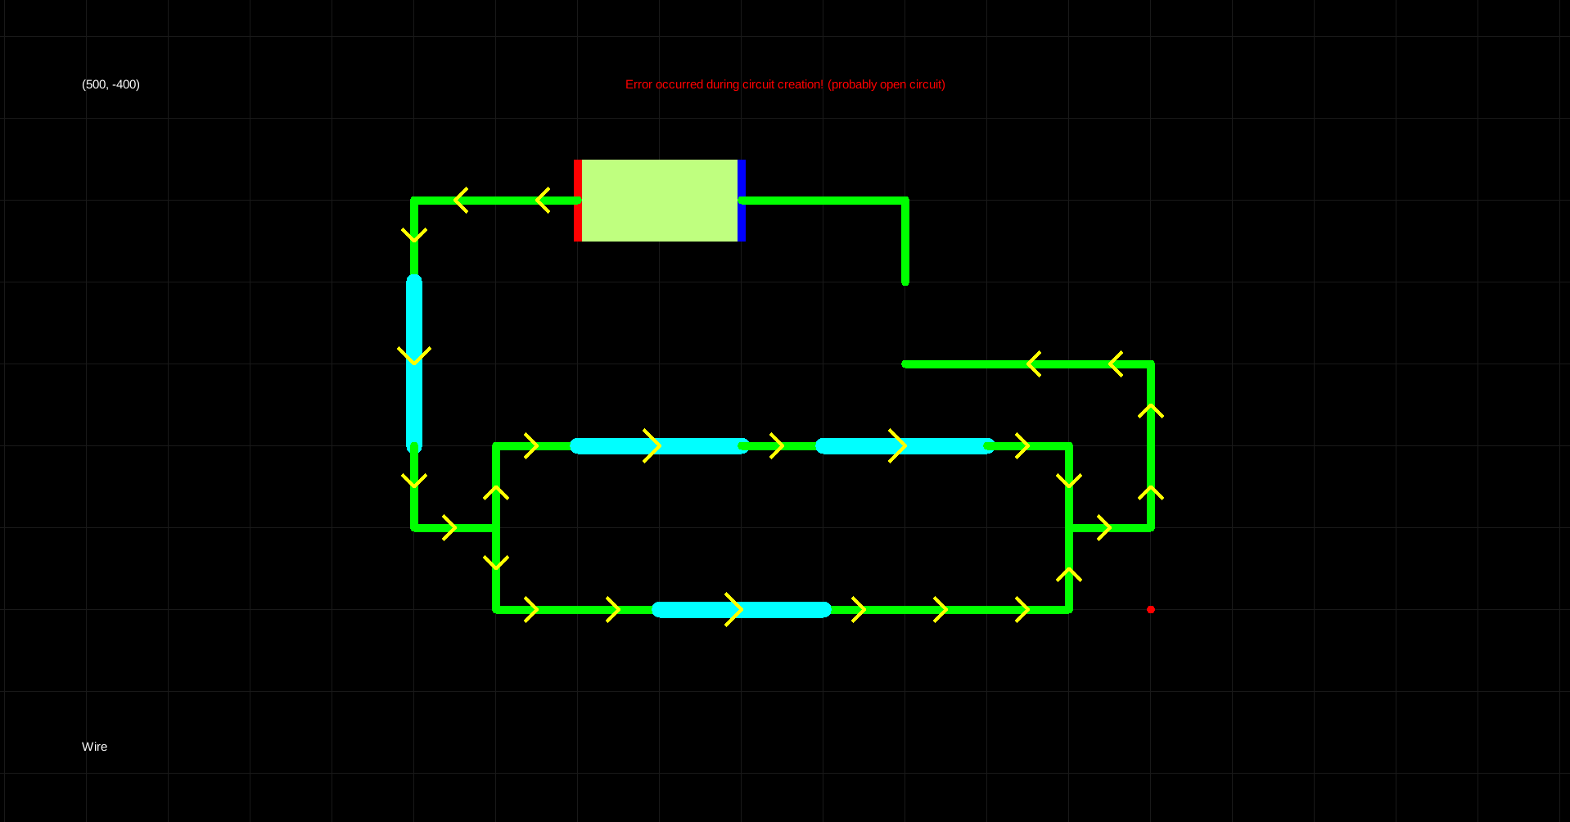

Slide 9
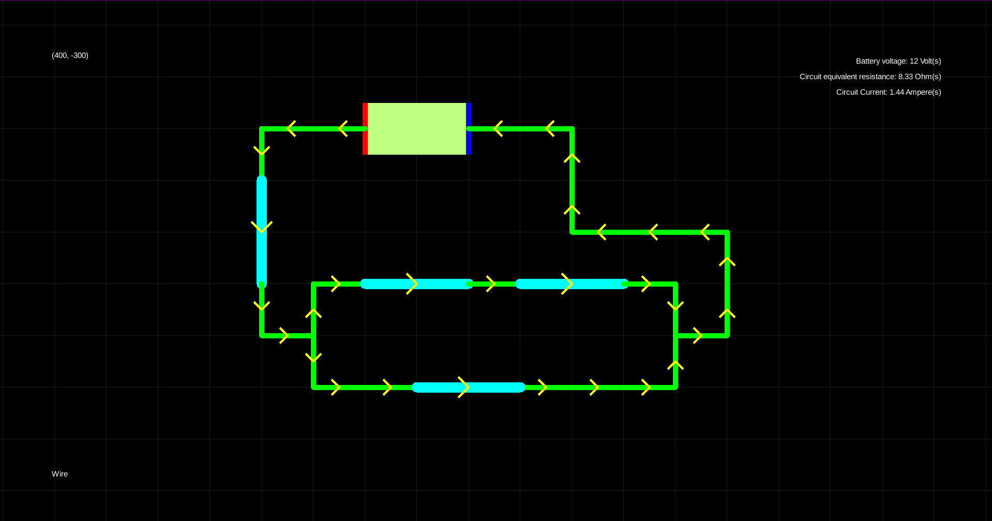

Slide 10
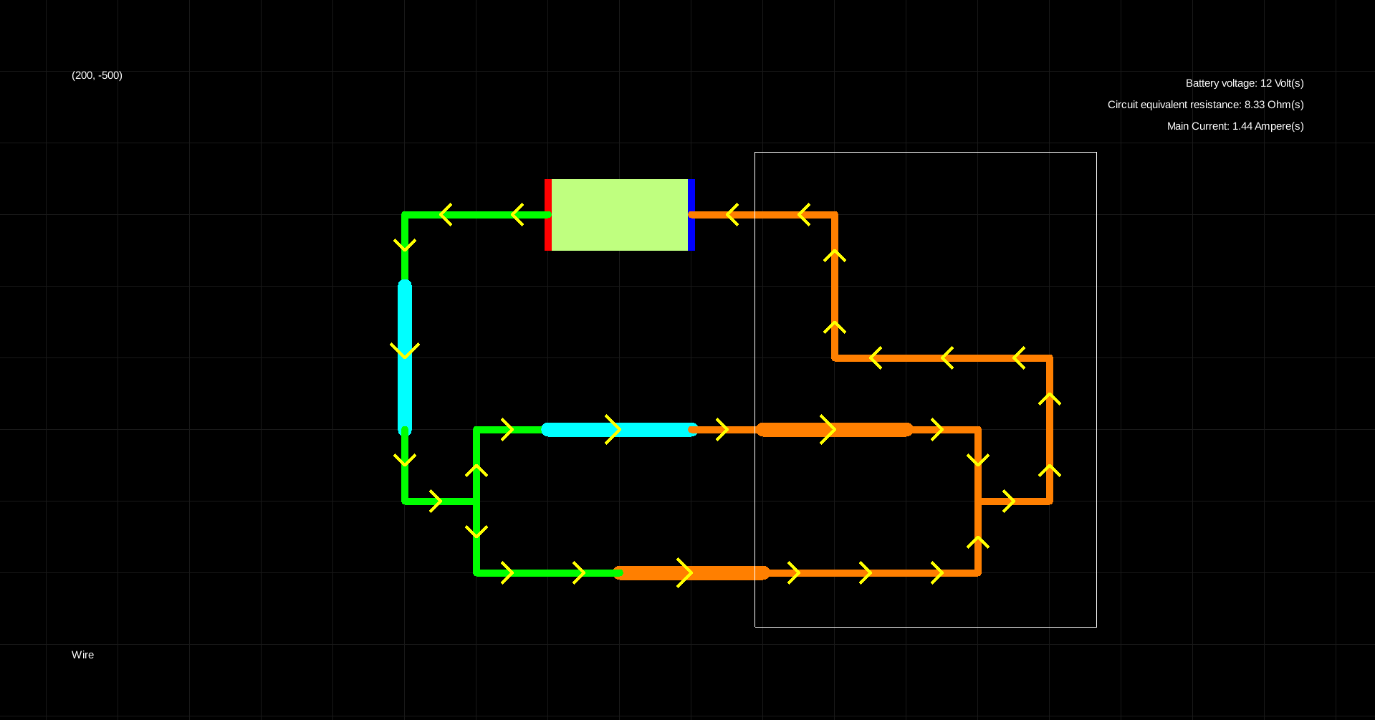

Slide 11
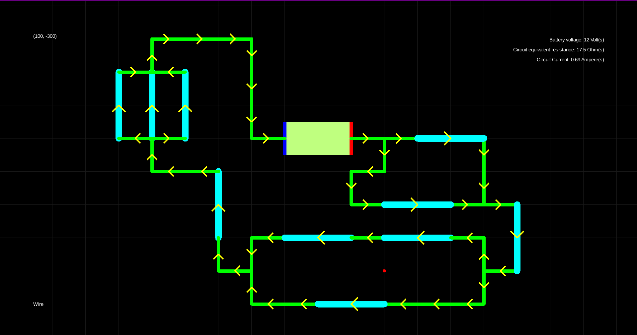
Proof:
Each resistor has a resistance of 5 Ohms,
Equivalent resistance:
5 + 5 + (1/5 + 1/5)^-1 + (1/10 + 1/5)^-1 + (1/5 + 1/5 + 1/5)^-1 = 17.5 Ohms
Current: 12/17.5 = 0.69 Amperes

Slide 12
Thank you
The project is public and is available on my Github with user bigdubz:
https://github.com/bigdubz

